Slide 1
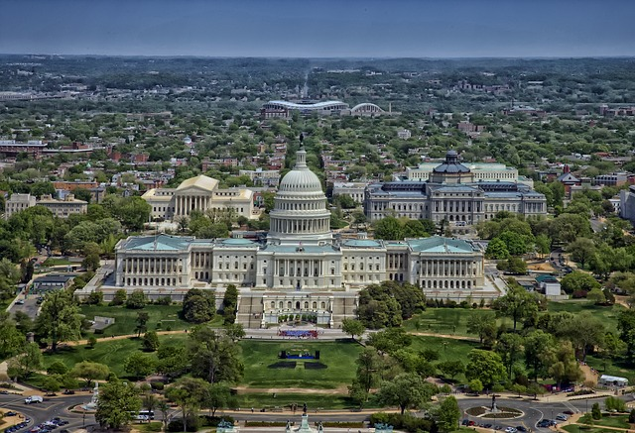
Washington D.C.

Slide 2
Washington, D.C., formally the District of Columbia and commonly referred to as "Washington", "the District", or simply "D.C.", is the capital of the United States.
Named in honor of President George Washington.
There live about 600 000 people.

Slide 3
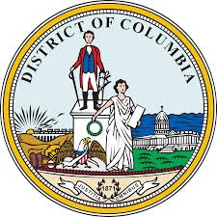
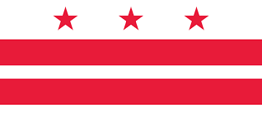
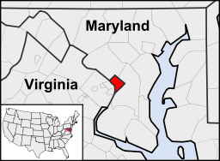
Flag and seal
Washington, D.C., is located between Maryland and Virginia

Slide 4
The White House
The White House is the official residence and principal workplace of the President of the United States.
The White House is the only presidential residence in the world that is open to visitors. Admission is free.
John Adams is the first President who moved into the White House on the 1st November 1800.

Slide 5
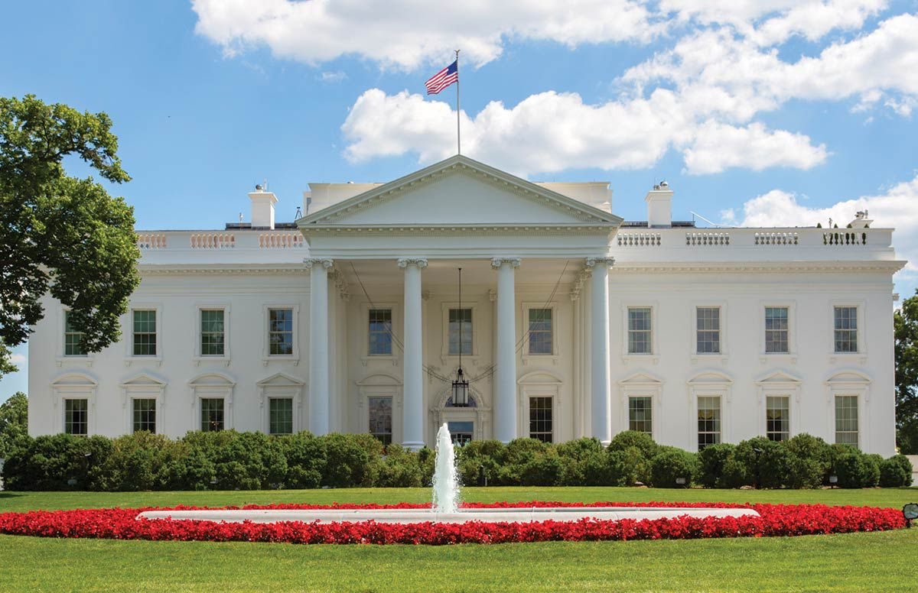

Slide 6
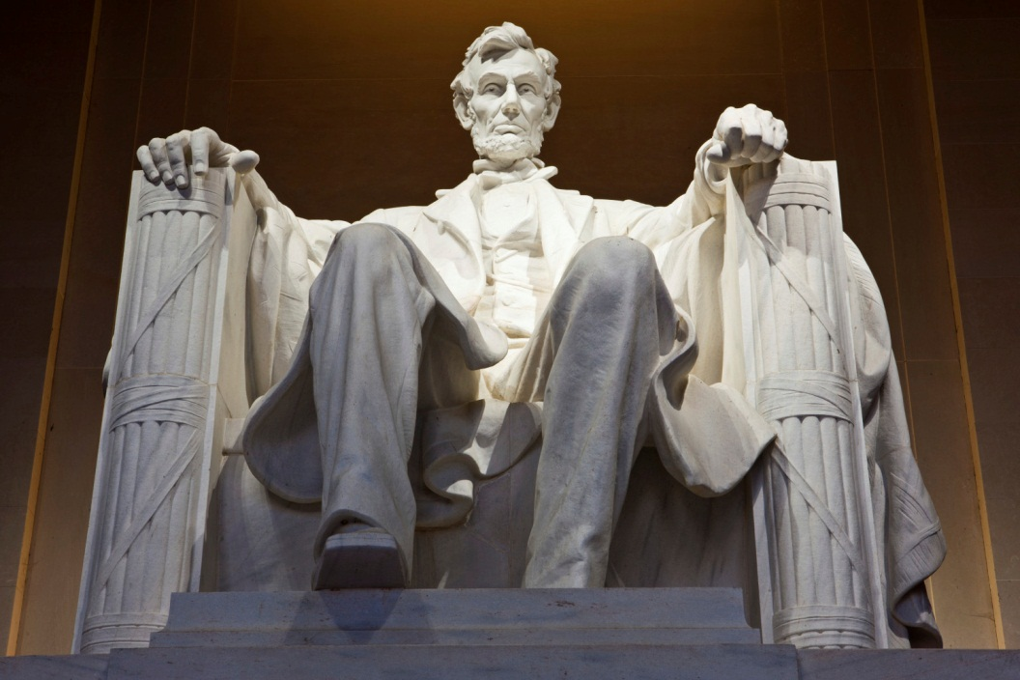
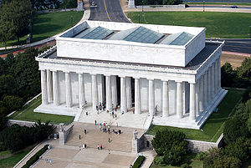
The Lincoln Memorial
The Lincoln Memorial is an American national monument built to honor the 16th President of the United States, Abraham Lincoln

Slide 7
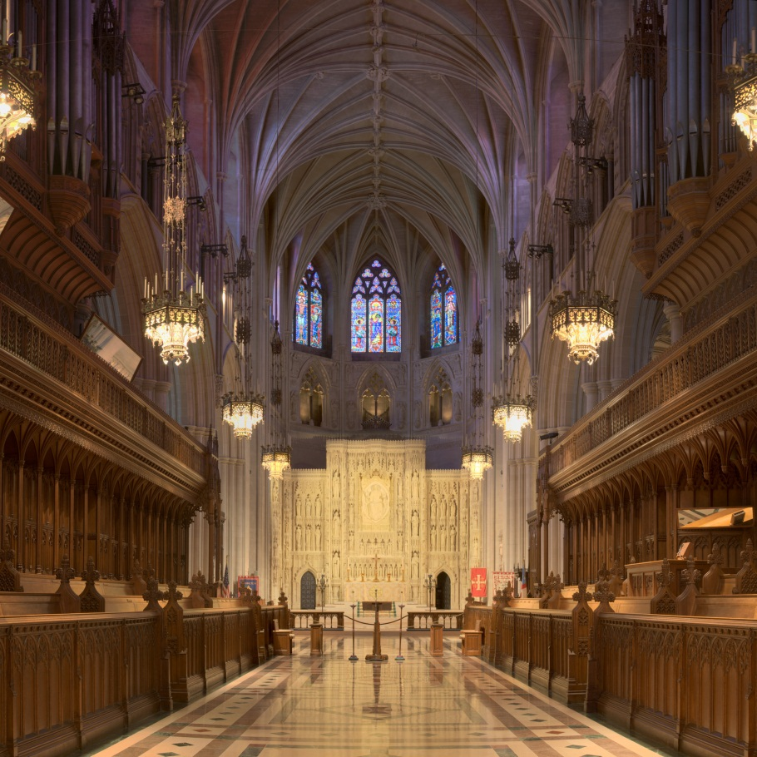
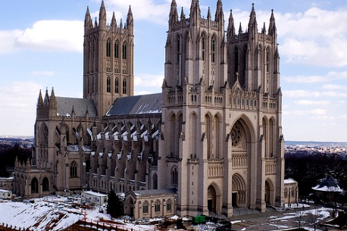
Washington National Cathedral
The Cathedral Church of Saint Peter and Saint Paul in the City and Diocese of Washington.

Slide 8
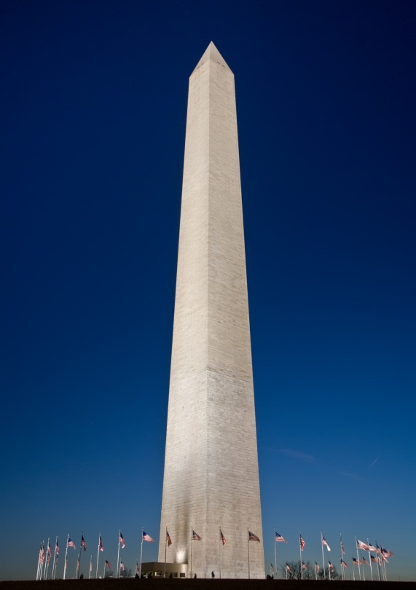
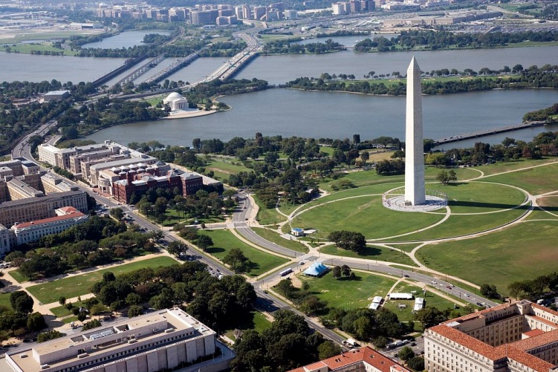
Washington Monument
The Washington Monument is an obelisk on the National Mall in Washington, built to commemorate George Washington.

Slide 9
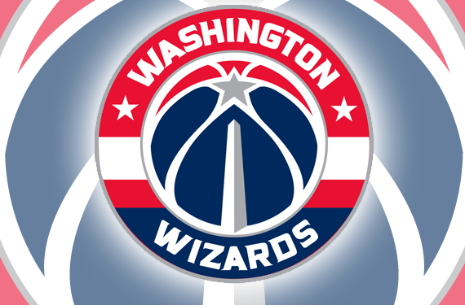
Washington Wizards
The Washington Wizards are an American professional basketball team from Washington, D.C.
This is my favorite team in the NBA.

Slide 10
THE END
The presentation was made by: Sebastian Orak

