Slide 1
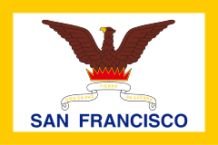
San Francisco

Slide 2
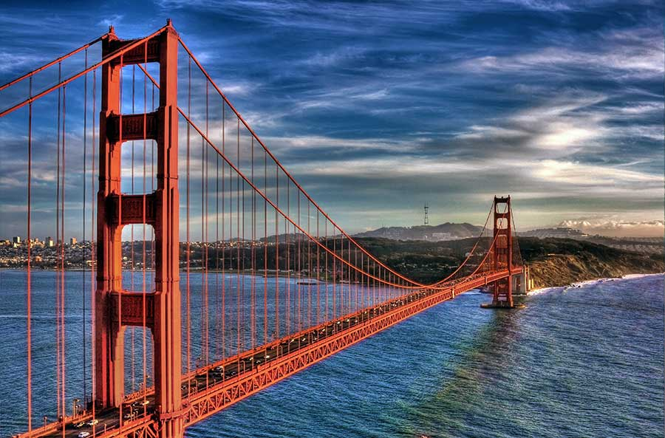
San Francisco is the best known by Golden Gate Bridge.

Slide 3
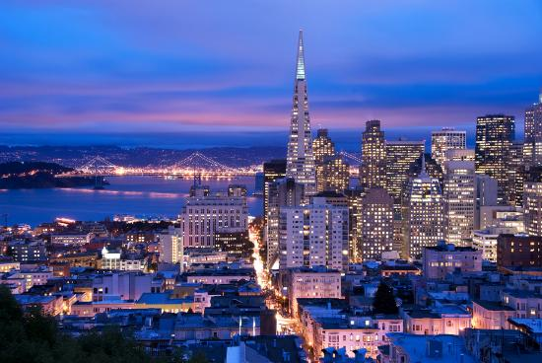
San Francisco is the second-most densely populated major city in the USA after New York.

Slide 4
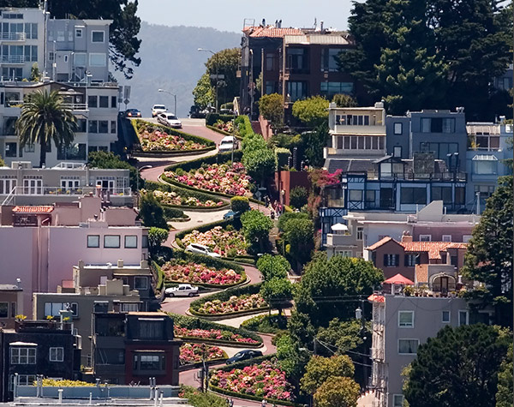
Lombard Street is an east-west street in San Francisco. It’s famous because the street is steep , one-block section with eight hairpin turns.

Slide 5
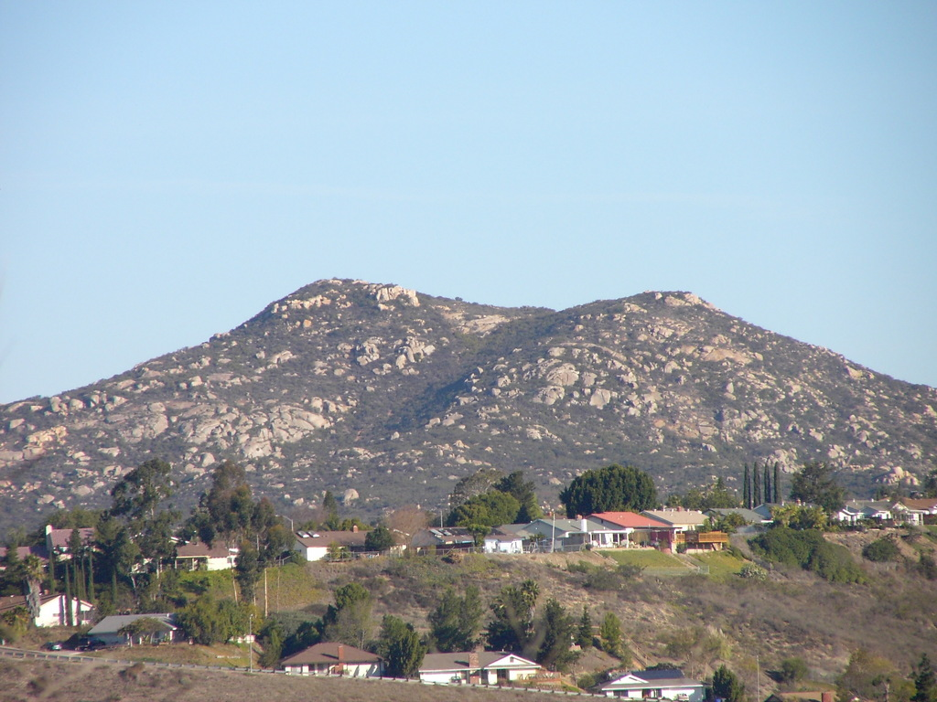
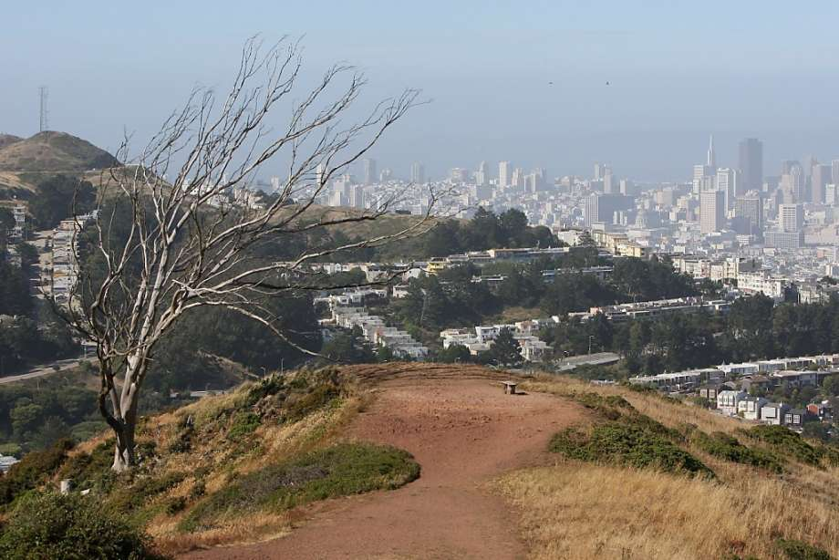
Near the city are a series of less densely populated hills: Twin Peaks and Mount Davidson.

Slide 6
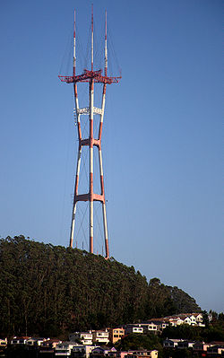
Dominating this area is Sutro Tower, a large red and white radio and television transmission tower.

Slide 7
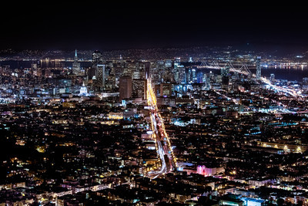
I would like to visit San Francisco.

Slide 8
The end
Ivan Mrazović

