Slide 1
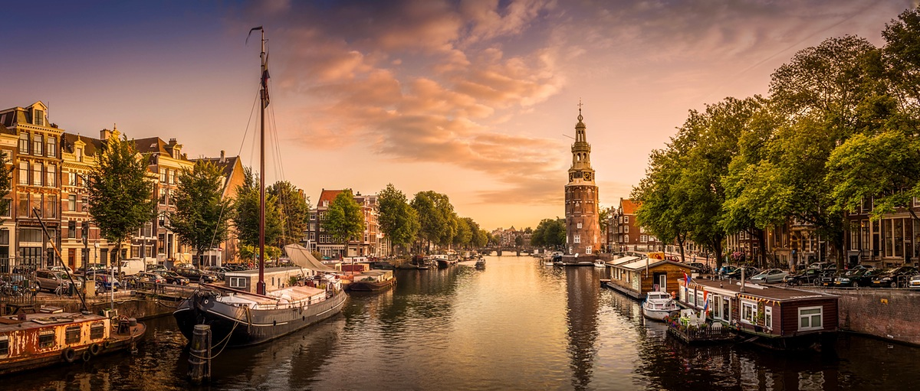
AMSTERDAM
Tea Benko, 7a

Slide 2
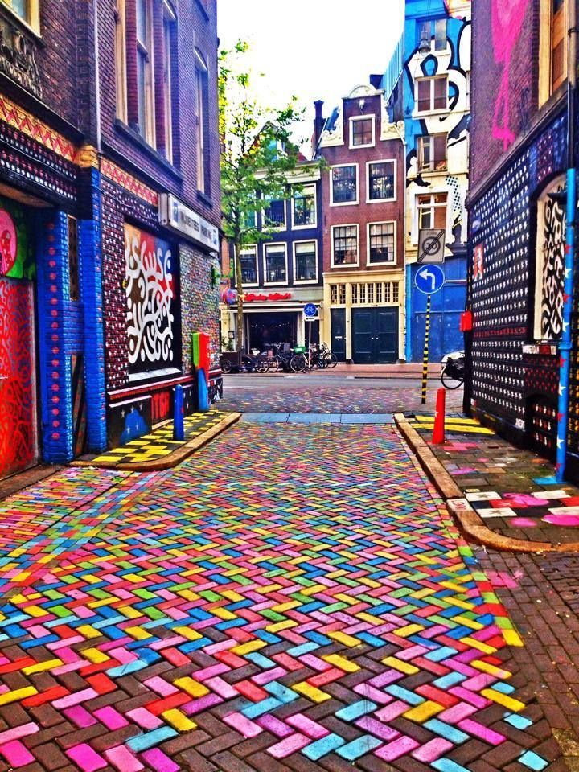
Amsterdam is the capital and cultural center of Netherlands.

Slide 3
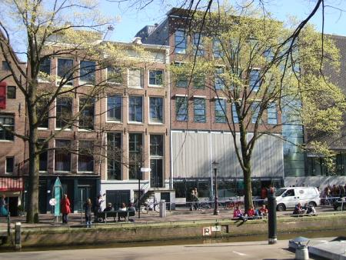
Anna Frank House
Anna Frank House is a museum.

Slide 4
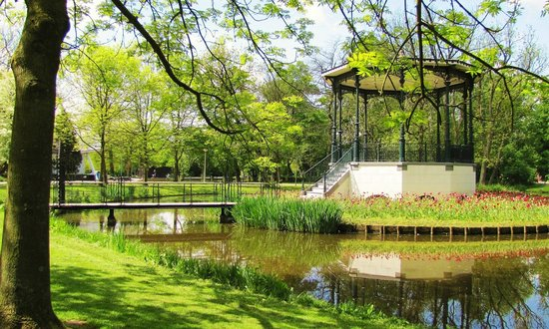
Vondelpark
Vondelpark is a public urban park.

Slide 5
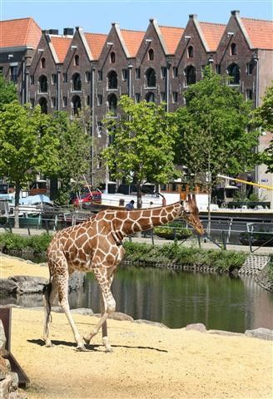
Natura Artis Magistra
Natura Artis Magistra is the zoo.

Slide 6
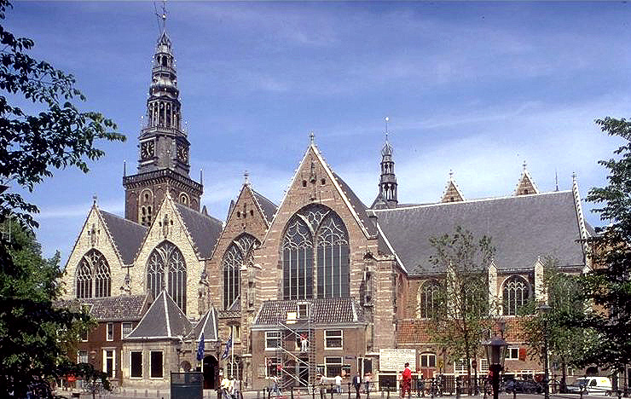
Oude Kerk
Oude Kerk is the church.

Slide 7
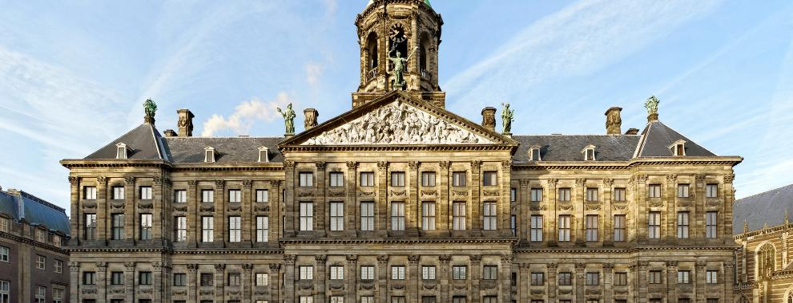
Royal Palace
Royal Palace is a famous palace.

Slide 8
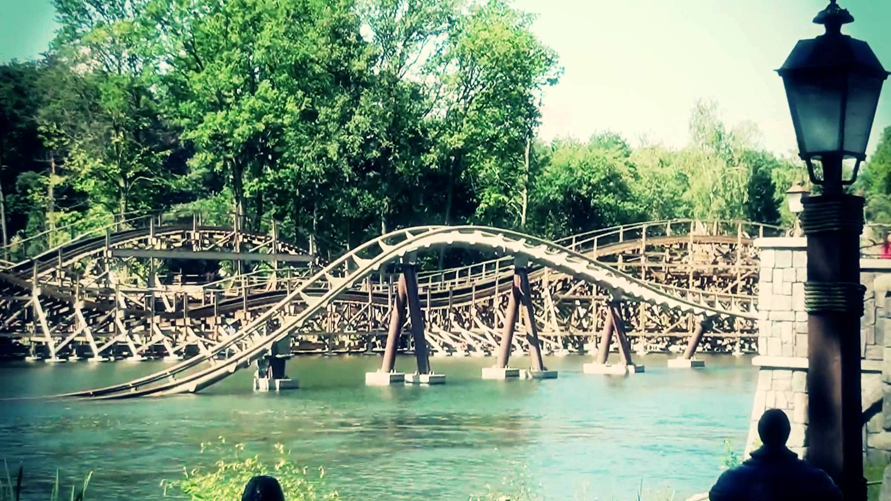
Efteling
Efteling is an amusement park.

Slide 9
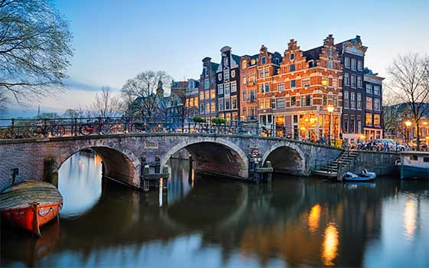
There are many museums, parks and squares in Amsterdam.

